Slide 1


Social Work - Back to the future
Ian Rees
Consultant Social Worker
Neath Port Talbot Social Services

Slide 2
Social Work - Back to the future
Our practice has developed out of an Outcome Focus model, that places ‘What Matters Conversations’ at the heart of our practice.
Our focus is about partnership working with families through a Child in Need approach.
Notes:
A quick plug for NPT

Slide 3
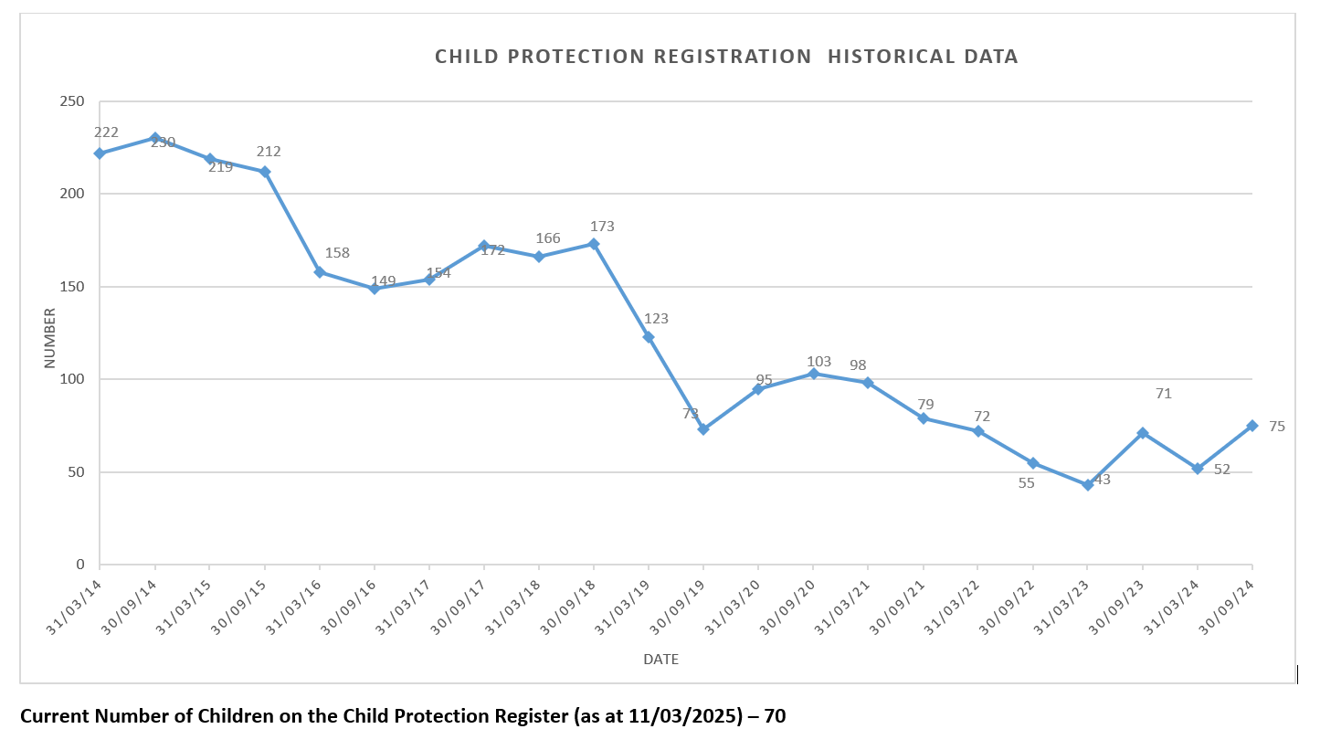
Social Work - Back to the future
In September 2014 we had 230 Children on the Child Protection Register
Currently we have around 75 on the register and have seen the CP registrations fall to as low as 43.
At present, as an Authority we have around 24 cases in PLO.
Notes:
Our work reflected in our stats

Slide 4
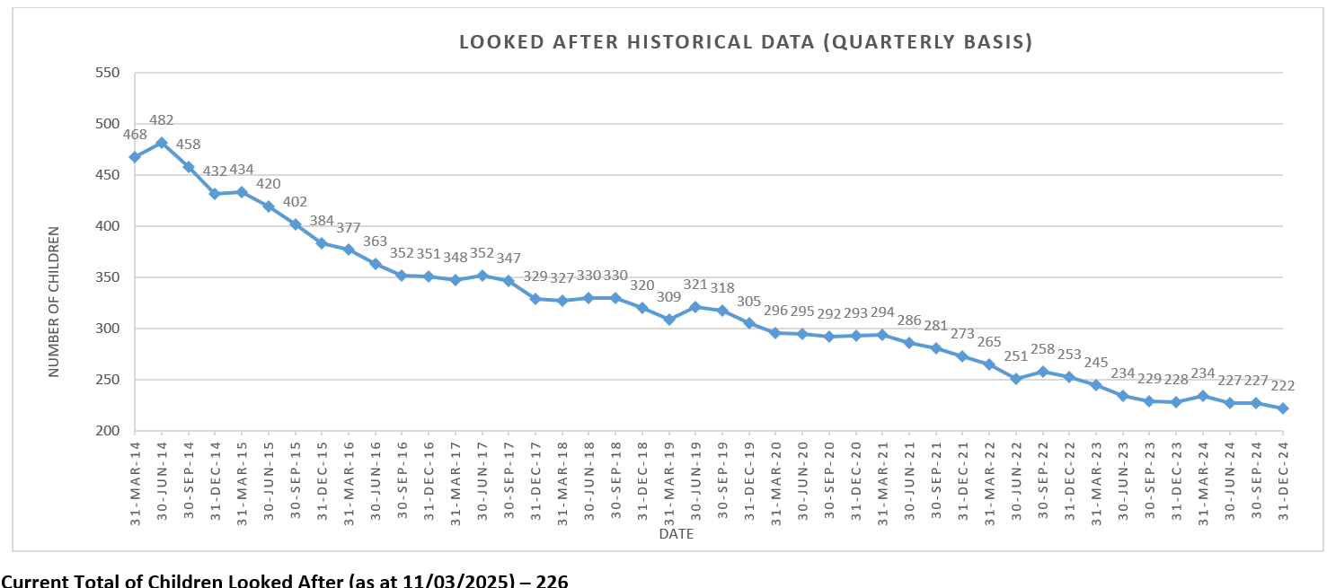
Social Work - Back to the future
In June 2014 we had 482 Children being Looked After, which was the one of highest in the UK
Over the past 11 years, we have more than halved that number currently we have 226 children being looked after. Many of whom are a legacy from 2014
Notes:
Our work reflected in our stats

Slide 5

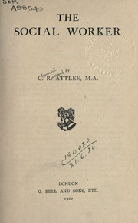
Social Work - Back to the future
The Social Worker
Written in 1919 directly after the First World War and published in 2020.
Clement Attlee argued in his book ‘The Social Worker’ for a new kind of National Service, which he called a ‘Social Services’.
Notes:
Intro to Attlee
Also, Attlee and the foundation of the NHS

Slide 6

Social Work - Back to the future
The Social Worker
This was not about a mobilisation of the population to fight a Great War.
But a call for men and women to be part of a “national mobilisation for the good of all”.
Notes:
His concept of Social Services and Social Workers

Slide 7
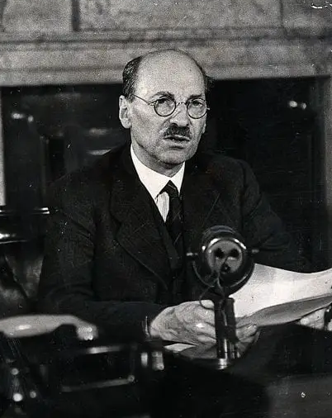
Social Work - Back to the future
On Poverty Attlee also argued—
“Today the social worker can profit by the labours of his predecessor, the ground has been explored and mapped out.
Research has been made into almost every phase of poverty, and many of its causes have been elucidated."
Notes:
Attlee on Poverty

Slide 8
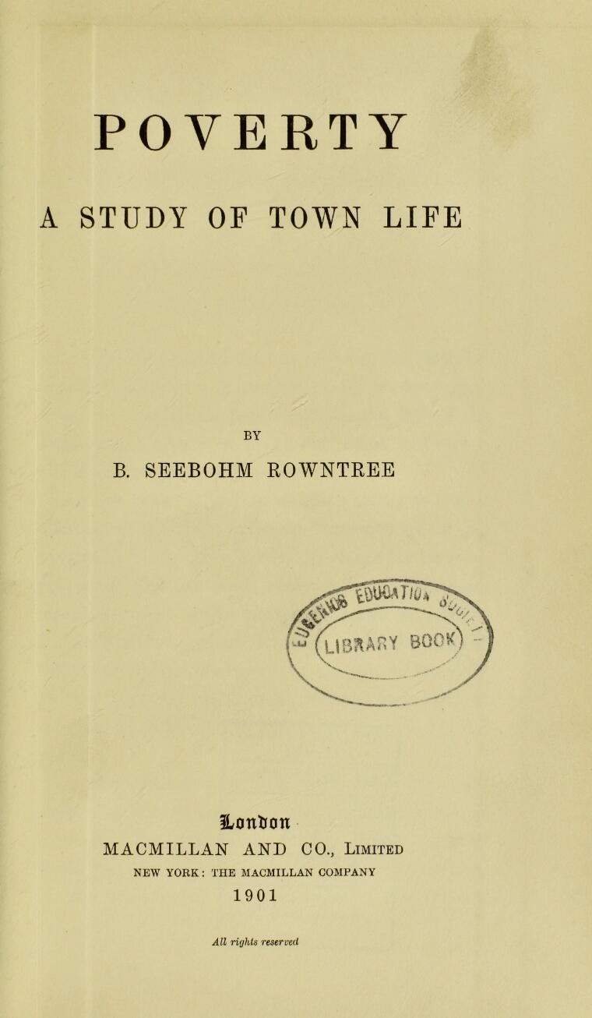
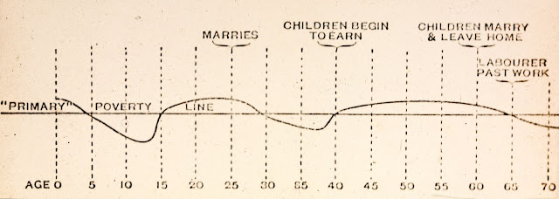
Social Work - Back to the future
York Study A Study of Town Life
The York study by Benjamin Seebohm Rowntree who was one of the first attempt to understand the true cost of living.
Notes:
Informed research into Poverty
Grandson was Frederic Seebohm, Seebohm Report 1968
Following the recommendations of the Seebohm Commission in 1968, the Local Authority Social Services Act 1970 received royal assent on 29 May 1970. The act created a framework for social services and a single social services department in every local authority.

Slide 9
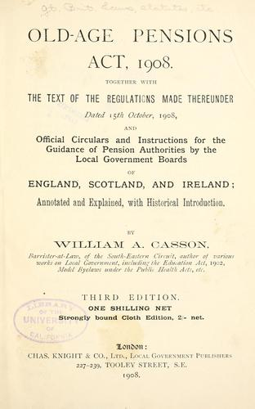
Social Work - Back to the future
The finding from the York study later informed—
Education act 1906 - resulting in the start of free school meals.
Old age pensions act of 1908.
The National Insurance act 1911, which was the first employment insurance contribution system against illness and unemployment
Notes:
Which meant that our first Welfare benefits was based on informed research
Pension act set a political value not a living value, had to be of good caricature, i.e. Not jailed in 10 years previous or fined under the inebriation act, means tested 5 shillings for single 7.6 shillings for couples per week earning under £21pa and no payment for those earning over £31pa.

Slide 10
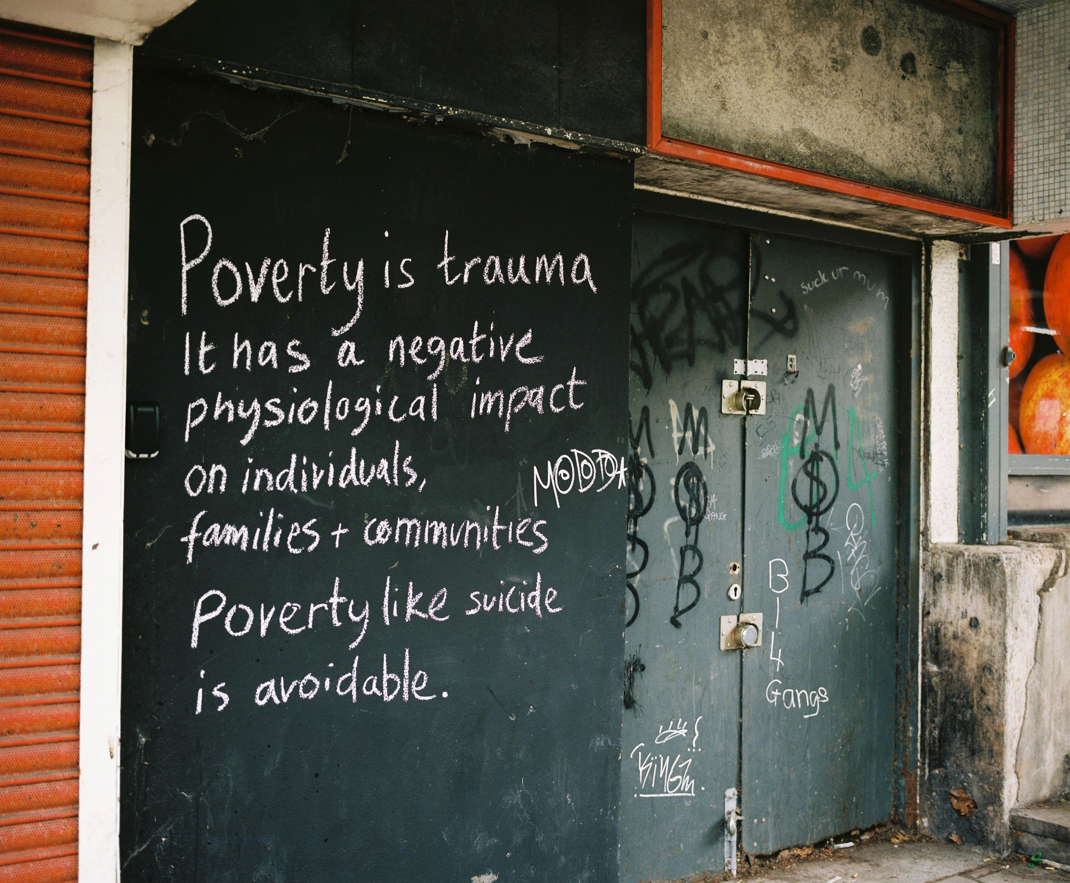
Social Work - Back to the future
What is
Poverty
Like Now
Photo from Kirsty Mackay from The Magic Money Tree.
Notes:
Intro to update on Poverty Now

Slide 11
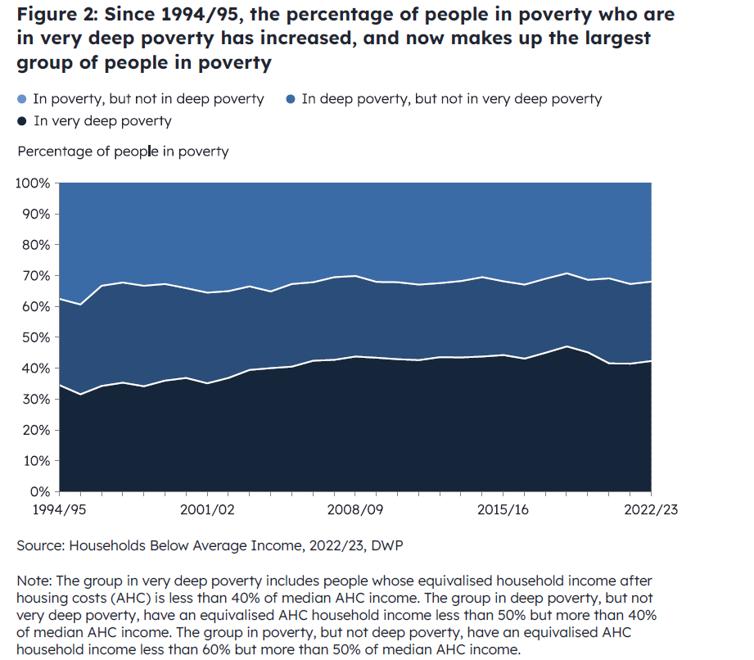
Social Work - Back to the future
“Overall, the rates of relative family poverty in the UK have been constant for about twenty years at around 22%.
But the numbers living in deep poverty or destitution have been rising rapidly over recent years
(Joseph Rowntree Foundation, 2022).
Graph - UK Poverty 2025 The essential guide to understanding poverty in the UK Josph Rowntree Foundation
Notes:
Deep Poverty has steady risen and where we can see a dip was due to the Covid top-up payment Covid: Universal credit £20 top up to be phased out 2021 where deep poverty has risen again

Slide 12
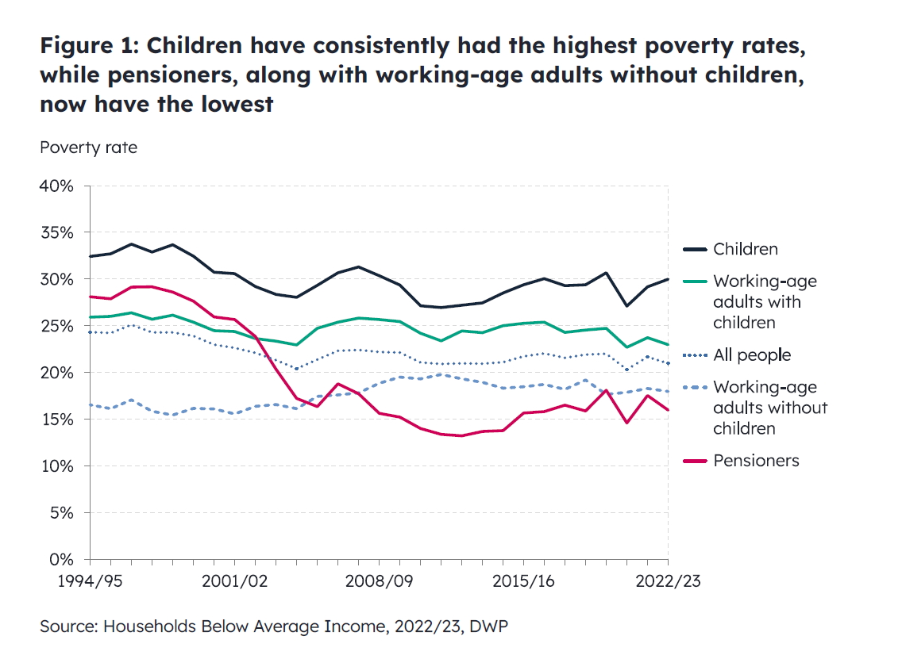
Social Work - Back to the future
The Joseph Roundtree Foundation estimates that around 3.8 million people in 2022 could be classed to be in Deep Poverty.
It also estimates that around 1,000,000 Children are living in —
“horrifying levels of Destitution”
Josph Rowntree Foundation - 2024
Notes:
Child Poverty

Slide 13
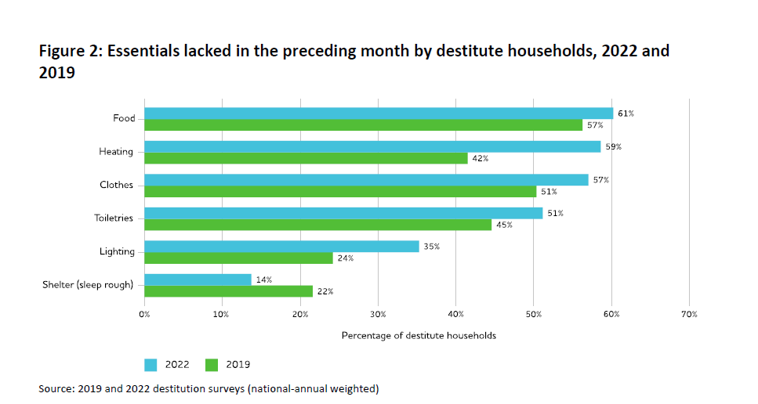
Social Work - Back to the future
“ Destitution is no longer a rare occurrence in the UK. Around 1.8 million households were destitute in the UK at some point over the course of 2022….”
“Between 2017 and 2022 the overall number of households experiencing destitution more than doubled”.
Destitution in the UK 2023 Joseph Rowntree Foundation
Notes:
The Rise in Destitution
People are considered destitute if they have lacked two or more of the following six essentials over the past month because they cannot afford them: Shelter (they have slept rough for one or more nights) which is the only one that has dropped, again this is due to the Covid strategy of housing rough sleepers.
All the other Destitution headings have significantly increased, estimated by 100% since 2017.
Food (they have had fewer than two meals a day for two or more days).
Heating their home (they have been unable to heat their home for five or more days).
Lighting their home (they have been unable to light their home for five or more days).
Clothing and footwear (appropriate for the weather).
Basic toiletries (such as soap, shampoo, toothpaste and a toothbrush).

Slide 14
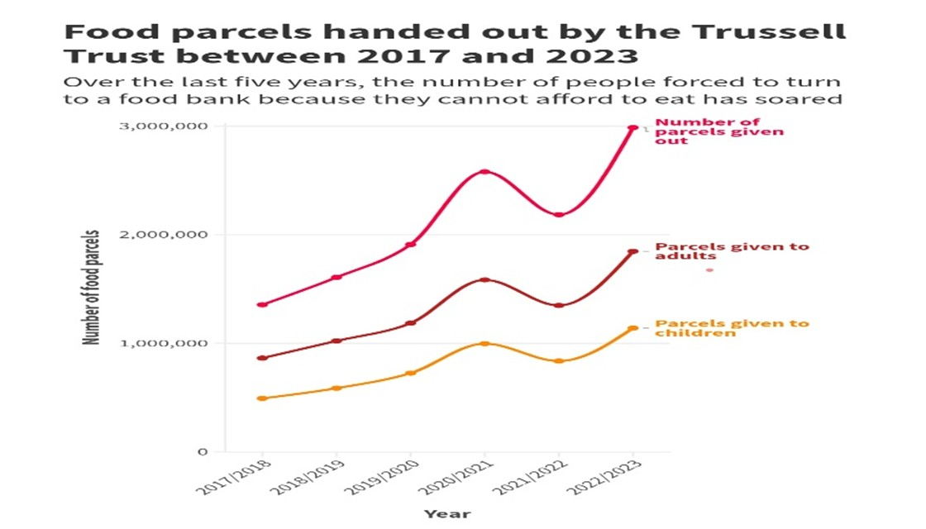
Social Work - Back to the future
“Nearly two thirds (63%) of emergency food parcels provided by Trussell’s community of food banks go to families with children…
A quarter of children (24%) aged 0-4 are facing hunger and hardship – a higher figure than for any other age group.”
​Article: Why 2025 is a big year for
tackling hunger and hardship​ | Trussell
The Trussell Trust data is drawn from its 1699 locations in the UK. There are at least another 1172 independent foodbanks in the UK.
Notes:
Food Bank data
Trussell is the largest of the UK foodbanks, but they only represent just under half of all foodbanks.
e.g In Port Talbot we have two main Trussell Trust foodbanks, and around another 6 to 7 smaller independent foodbanks or pantries.
It is often difficult to map the presence of foodbanks due to project setting up and closing.

Slide 15

Social Work - Back to the future
Proof That Poverty Is Not Failure But A Trap
“Poverty matters and it lasts.
It reduces wellbeing today and limits life chances tomorrow.
That’s why it’s a disgrace that in the UK the incomes of the poorest families are like in the pre-crisis years, leaving them no higher in 2018-19 than in 2001-02.
That’s not what progress looks like - but is what big benefit cuts produce.”
Torsten Bell
Director of the
Resolution Foundation
Resolution Foundation 2020
https://www.resolutionfoundation.org/comment/contagious-theories-and-proof-that-poverty-is-not-failure/
Notes:
Introduction to Torsten Bell and his views while at the Resolution Foundation on Poverty
Key point that typical low income household have not seen any financial lift in nearly 20 years.

Slide 16
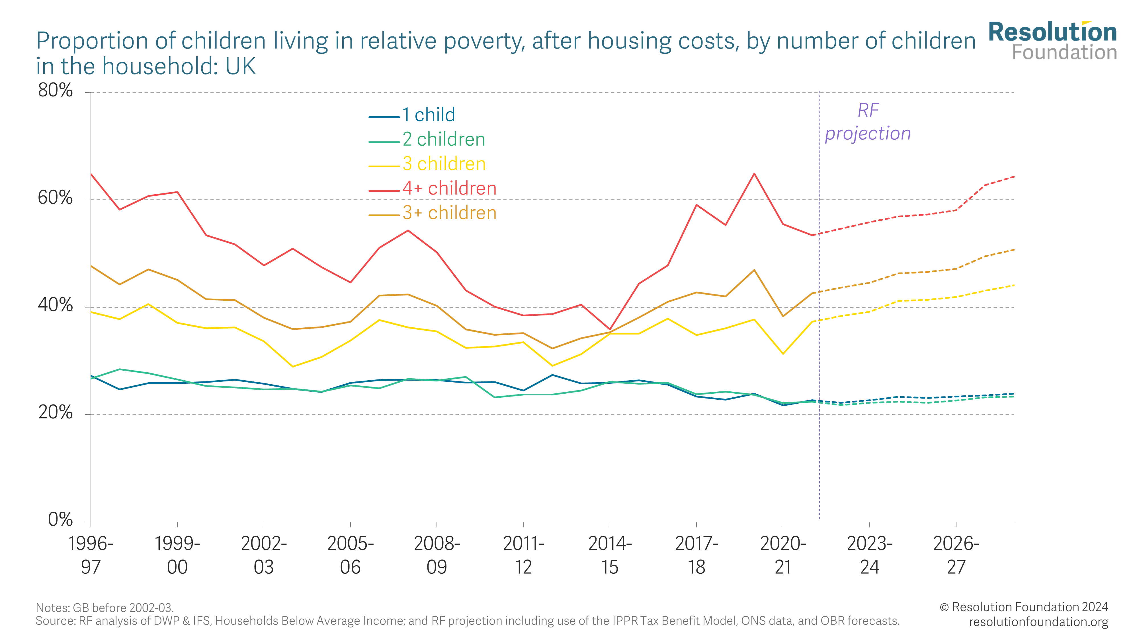
Social Work - Back to the future
Torsten Bell
Director of the
Resolution Foundation
Web Article — Catastrophic Caps • Resolution Foundation - January 2024
Notes:
As Director of the Resolution Foundation, he projected impact of the two-child benefit cap on large families
In 2024 he became Labour MP for Swansea and after Labour one the election, the SNP tried to get parliament to scrap the two-child benefit cap, which was voted down by Labour and Torsten Bell

Slide 17
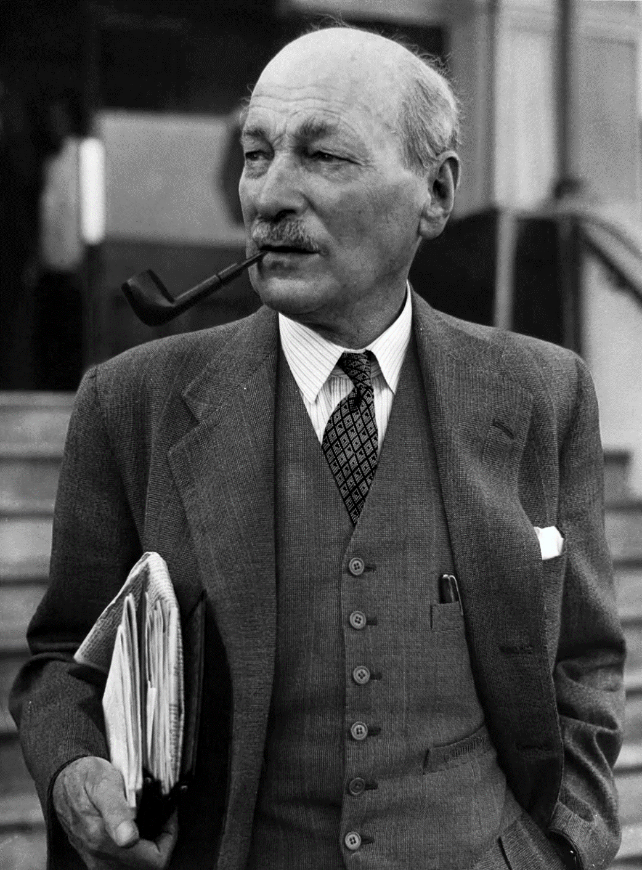
Social Work - Back to the future
“I met a small boy in the street one day and we walked along together.
“Where are you off to?” said he.
“I'm going home to tea”, said I.
“Oh, I'm going home to see if there is any tea”, was his reply”
... “It is well to keep clearly in mind, if you are one of those to whom meal-times come with almost monotonous regularity, that to others there is the question always present where tomorrow's dinner to come from?”
Notes:
A quote from Attlee in response to the Labour and Torsten support of the two-child benefit cap.
Quote drawn from article –
Clement Attlee and the foundations of the British welfare state Rachel Reeves and Martin McIvor
“The early career of Clement Attlee reminds us that the welfare state was never intended to stand alone as a set of institutions. Its stability depends upon a set of ethical, economic, and political foundations.”
Also quoted in a Rachel Reves article in 2014
also relevance to the recent cut in International Aid Budget.

Slide 18
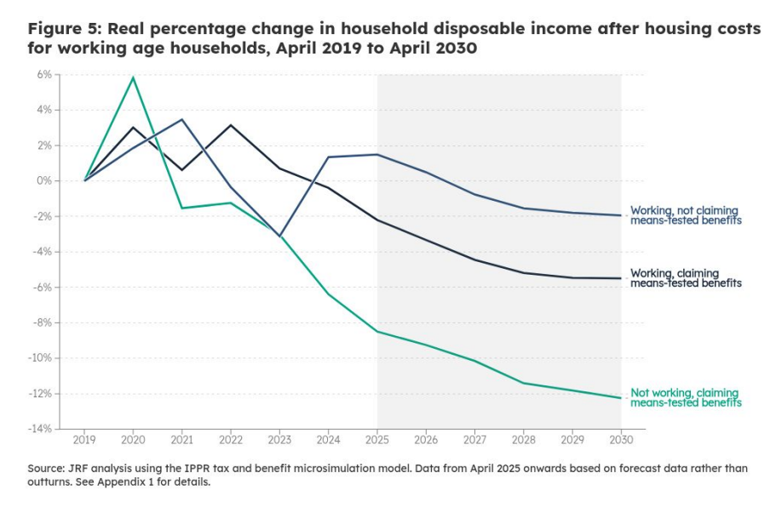
Social Work - Back to the future
“Single-parent families have experienced deteriorating living standards, with disposable income 6% lower in 2025 than 2019.
This is set to continue, with single parent families forecast to have £1,100 less in disposable income in 2030 compared to 2025.”
‘Starmer's missed milestone? The outlook for living standards at the Spring Statement’ -- JRF Briefing Notes March 2025
Notes:
JRF briefing of March 2025 showing the impact on living standards, particularly for single parents.

Slide 19
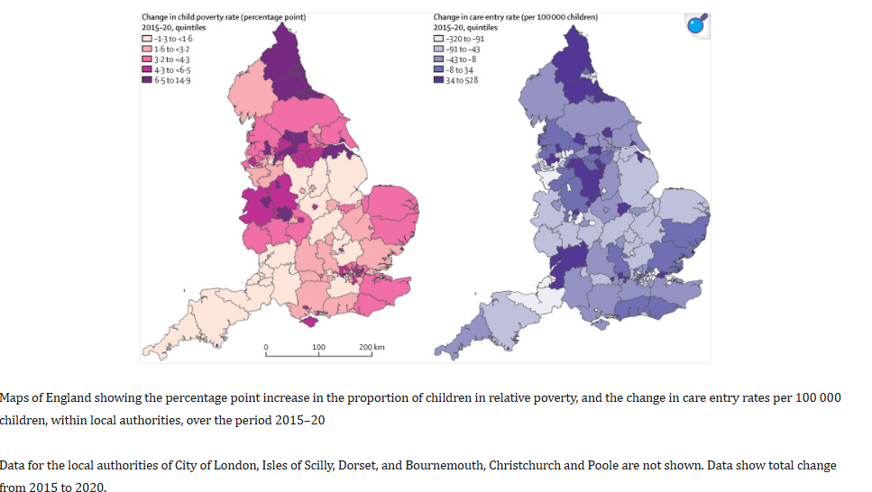
Social Work - Back to the future
A study by Liverpool University, found that between 2015 and 2020 and controlling for employment rates, a 1% increase in child poverty in England was associated with 5 additional children entering care per 100,000.
(Bennett_et_al, 2021)
The Joseph Rowntree Foundation, estimates that child poverty in Wales could increase to over 34% by 2029
So for Wales, we could equate an additional 50+ children coming into state care given that projected 2% increase in Child Poverty.
Economic and employment growth alone will not be enough to reduce poverty levels -- JRF January 2025
Notes:
Liverpool study linking child poverty to children coming into state care in England, if mapped against Wales, then given the JRF estimate of 2% increase in child poverty, we can project at least a further 50+ children coming into state care in Wales. But worth noting that Wales has one of the highest rates of child removals in Europe and significantly higher that in England

Slide 20
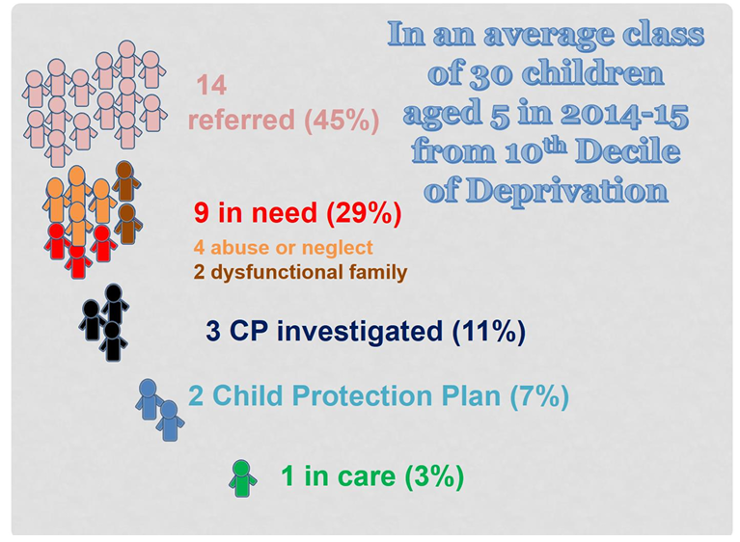
Social Work - Back to the future
“A large proportion of children in the most deprived communities will be involved with children’s social care and that many children will have been suspected of being neglected or abused before the age of five.
Since over half of all referrals and investigations concern children over this age the numbers drawn into the system before the age of 18 will be much higher. This level of investigation in deprived communities is of concern for many reasons.”
Bilson, A., Featherstone, B., Martin, K., (2017) How child protection’s ‘investigative turn’ impacts on poor and deprived communities. Family Law 47: 316-319
Notes:
Bilson and Featherstone Poverty and Child Protection
In Wales this ratio is likely to be higher due to the level of state intervention in family life.

Slide 21
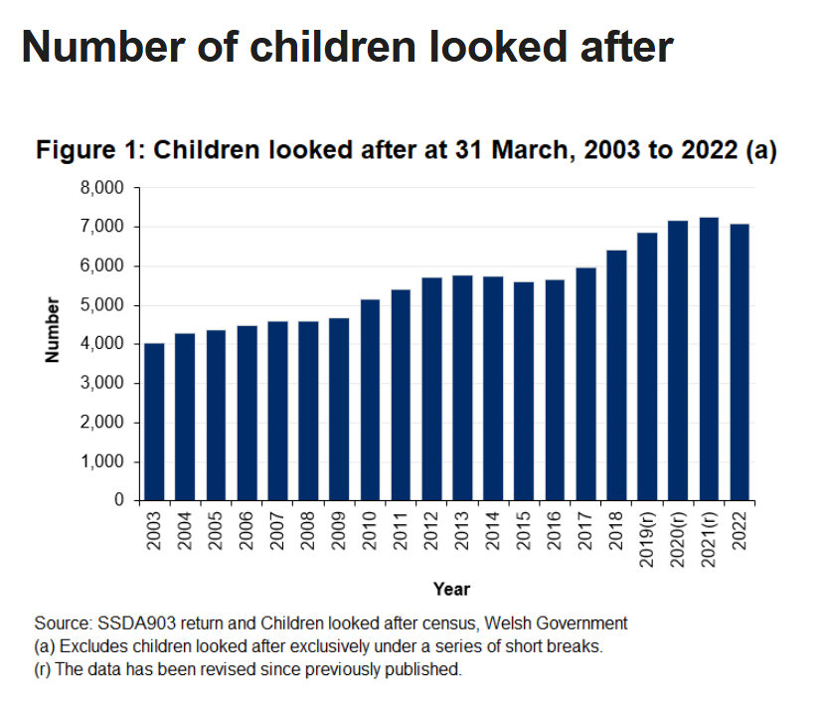
Social Work - Back to the future
“Child protection practitioners find it hard to incorporate ways of talking with families about complex and emotive issues surrounding poverty or to help families deal with or exit poverty.
Frequently, families’ socioeconomic status is not seen as core business, with agency priorities, structures and models of practice shown to be an obstacle to poverty aware practice.
As a result, parents too often feel a lack of recognition, that their concerns and priorities are not understood or heard, and view services as a source of threat rather than help”
Paul Bywaters & Guy Skinner-- The Relationship Between Poverty and Child Abuse and Neglect: New Evidence (2022)
Notes:
Bywater and Skinner reflection on Social Worker’s understanding on Poverty
Poverty increased at a faster rate after 2010.
Welsh data could also match the rise in poverty in Wales. Rember that in NPT while we have high rates of Child Poverty, but we have managed to reduce both other CLA and CPR over the same time Wales also incarcerations more women than anywhere else in Europe, approximately 80 per 10,000 where as Republic of Ireland the rate is around 40 per 10,000. Given that women tend to be main care givers and often is the main focus within Child Safeguarding, one has to ask the question if Wales have a large population of women with problems, or our services has a problem in supporting women.

Slide 22
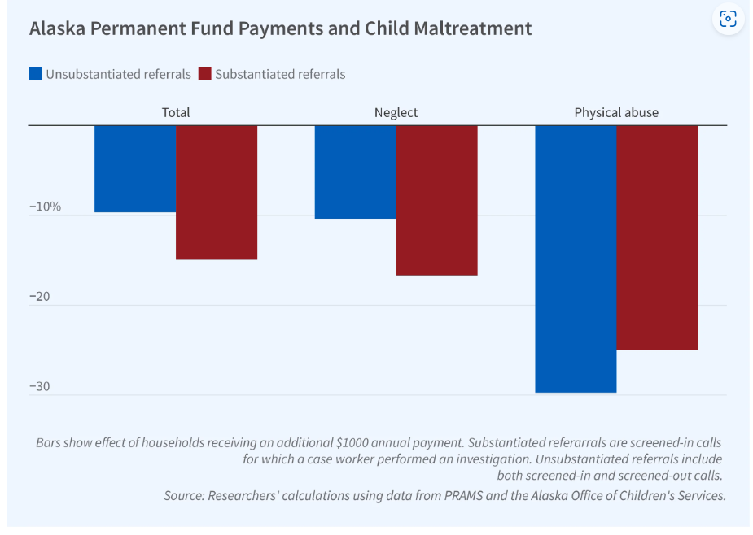
Social Work - Back to the future
The Alaska Permanent Fund Dividend (PFD)
$1,000 in early childhood PFD payments reduced total of all unsubstantiated maltreatment referrals by age three by 9.6%. and Substantiated referrals also drop by approximately 15%. Specific physical abuse referral also dropped by around 25% and 30% respectively.
Follow-up survey through to age of 5 year indicated a continued positive affect, including greater family stability. A further study on child mortality among children already involved with child welfare indicated a 30% decrease in mortality by age four.
Calculations based on the Centres for Disease Control and Prevention estimates of the lifetime cost of child abuse avoided at approximately $18.9 million, while the PFD payment cost was $4.5 million.
Effects of Universal and Unconditional Cash Transfers on Child Abuse and Neglect --
Lindsey R. Bullinger, Analisa Packham, and Kerri M. Raissian
Notes:
The Alaska Permanent Fund Dividend (PFD) is a universal basic income program that has provided annual cash payments to all Alaska residents since 1982. Unlike many other transfer programs, such as the Earned Income Tax Credit, the PFD is not conditioned on income or employment status. Payment amounts fluctuate annually and average around $1,600 per capita each year.
Effects of Universal and Unconditional Cash Transfers on Child Abuse and Neglect -- Lindsey R. Bullinger, Analisa Packham, and Kerri M. Raissian

Slide 23
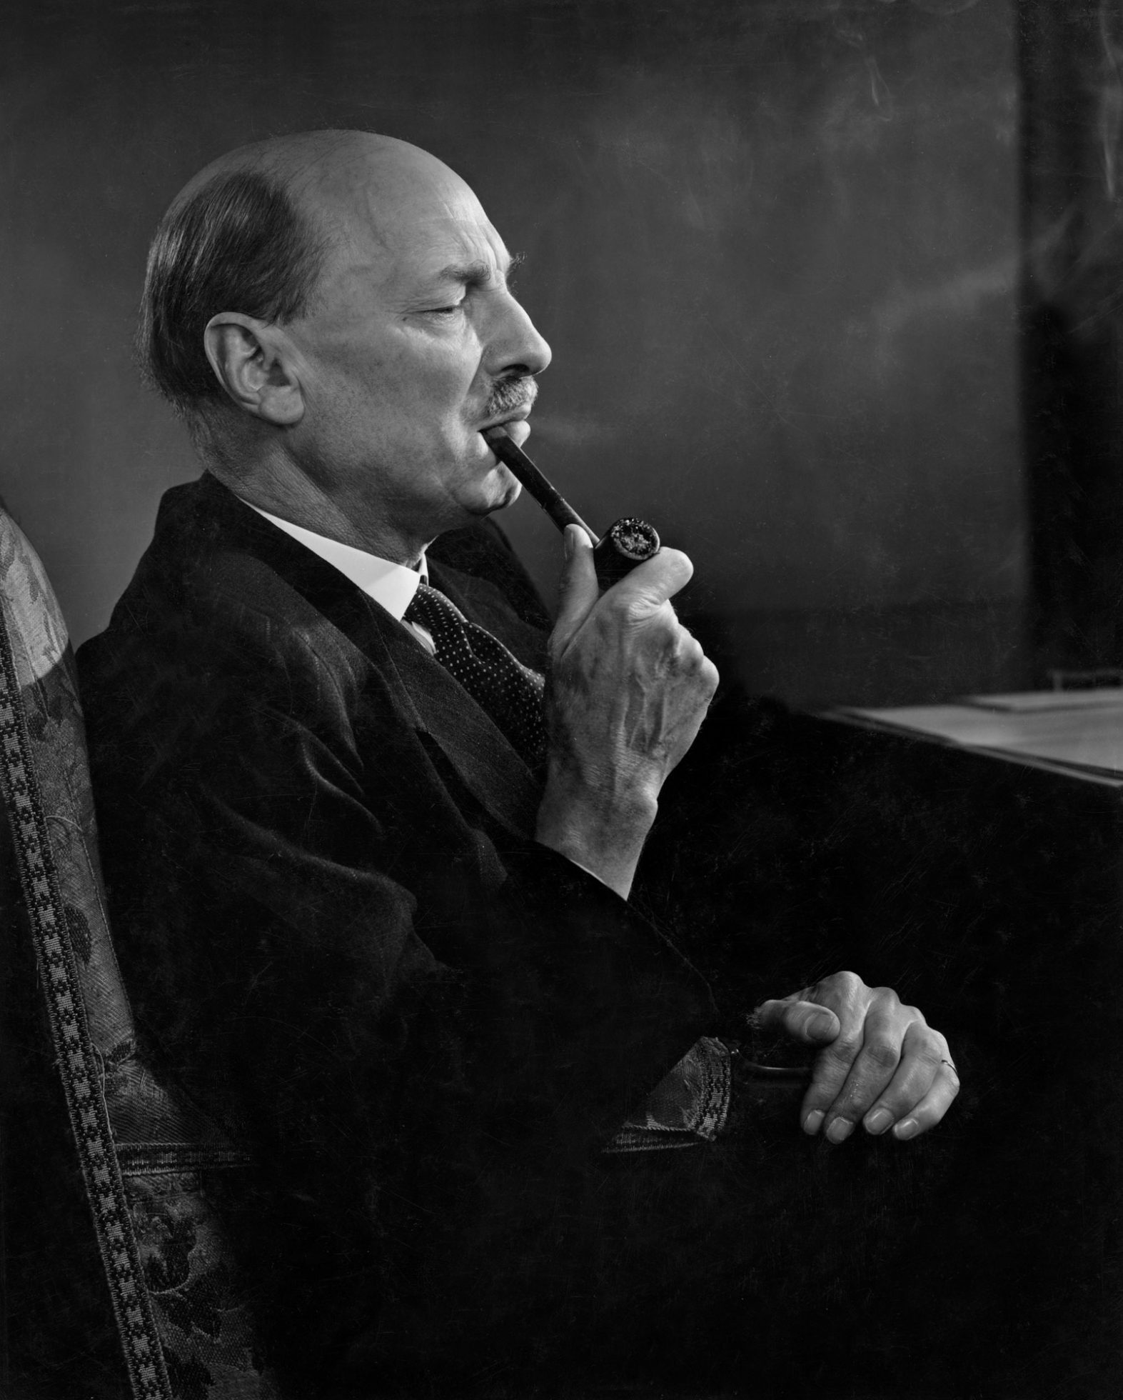
Social Work - Back to the future
“In all social work there is the great danger that must be avoided of treating people as cases, and grouping them in categories and statistical tables, so that one forgets that all the time one is dealing with individuals.”
Clement Attlee (1920)
Notes:
His words reflects much of the sentiment of Welsh Government policy

Slide 24
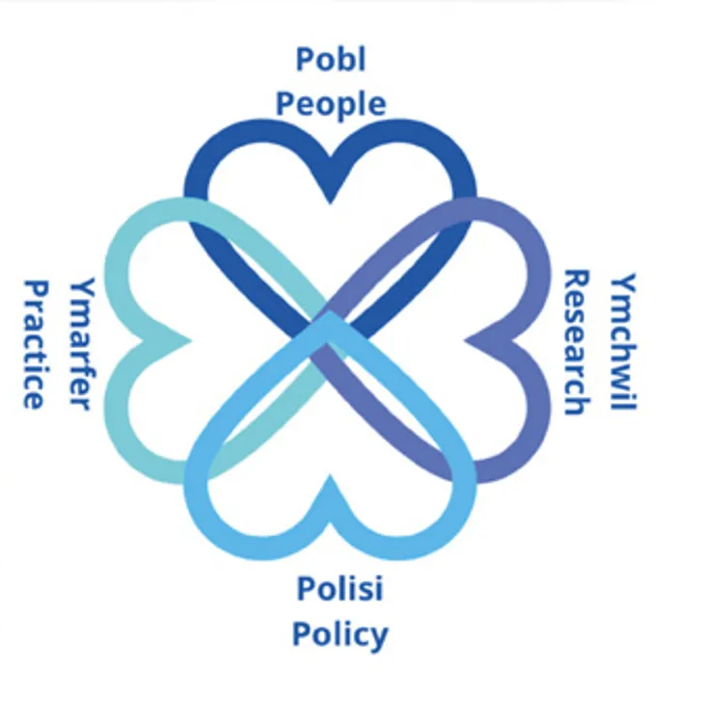
Social Work - Back to the future
Berwick, argues—
The more patients and families become empowered, shaping their care, the better that care becomes, and the lower the costs. Clinicians, and those who train them, should learn how to ask less,
‘What is the matter with you?’
and more, ‘What matters to you?’
(Berwick, D.M - 2016)
Notes:
Towards co-production ……………… DEEP logo

Slide 25

Social Work - Back to the future
Key Acts of Relevance in Wales –
The Social Services and Wellbeing (Wales) Act 2014
The Housing (Wales) Act 2014
The Future Generations (Wales) Act 2015
The Integrated Care Fund, Sustainable Social Services Third Sector Grants (formerly Section 64 grant funding) and the Transformation Fund
The Regulation and Inspection of Social Care (Wales) Act 2016
A More Equal Wales: The Socio-economic Duty Equality Act 2010
The Health and Social Care (Quality and Engagement) (Wales) Act 2023
Notes:
Based on the work of Prof Fiona Verity

Slide 26
Social Work - Back to the future
These Acts offer four common characteristics for public bodies to embrace —
Taking a long-term approach, by balancing what is immediate with safeguarding the future;
A Focus on prevention thereby, stopping problems occurring or getting worse;
Demonstrating a belief in integration, by continually thinking about the impact of your or your organisation’s actions on others;
Promoting coproduction and collaboration by continually involving people who want to be their best and supporting them to help others to do the same.
Notes:
Based on the work of Prof Fiona Verity

Slide 27
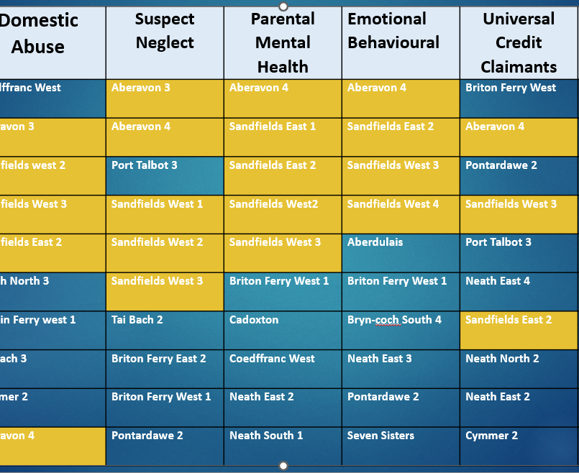
Social Work - Back to the future
Poverty Development Case Example
Data Mapping with Public Health Wales
Mapping out data against our Primary Schools and found a cluster of five neighbouring schools
Notes:
DATA work to inform community intervention - looking at Public Health Wales again in relation to SSD referals, helping to target community intervention.
Key examples Aberavon and Sandfields and UC

Slide 28
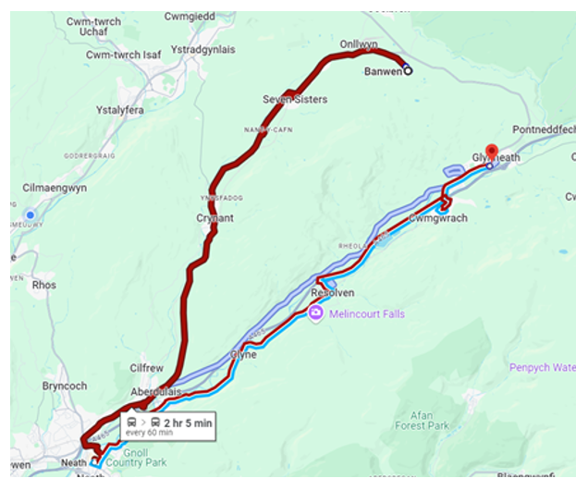
Social Work - Back to the future
Poverty Development Case Example
Transport Matters
Banwen to Glynneath
7 Minutes Car and a 4.3 Mile Journey
Banwen to Glynneath
2 Hours by Bus and a 9.3 Mile Journey
Notes:
An illustration of people in Banwen transport issues to access local shops and foodbanks in Glynneath
Bus cost over £7

Slide 29

Social Work - Back to the future
“No one wants to work with us Gypsies” – “We don’t work with Gypsies because Gypsies keep themselves to themselves”
2016 Developed a bridging project, which included a Needs Analysis (Verity 2022) Resulting in an Awareness Raising Conference 2019.
2020 Lockdown,
Now, we have two Wallich workers dedicated to supporting our local Romani and Traveller Community (250 individuals; NPT-GTAA ). Site arrears were running at over £100,000 p.a now down to around £50,000
Postal Service no mail for over 9 years, now a postal service has been resumed.
Roadside Encampments policies and Practices
Energy Cost; 2024 each plot received £1,000 energy grants (also now can access Warm Wales grants) Currently looking at energy management and support around solar energy and sympatric instillation.
Looking to set up a Women’s Well Being Group
Case Example Arising from Case Work
Notes:
It a bit condensed but give an example of shifting a Child Protection case to a systems intervention.

Slide 30
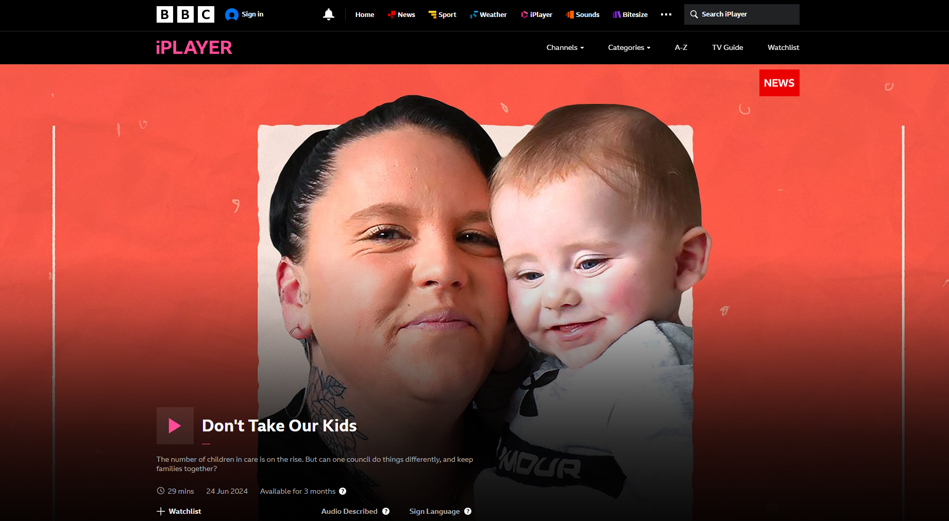
Social Work - Back to the future
Don't Take Our Kids –
BBC iPlayer
Ian Rees
Consultant Social Worker
Neath Port Talbot Social Services
i.rees1@npt.gov.uk
Notes:
BBC Doc – by India Pollock.

