Slide 1
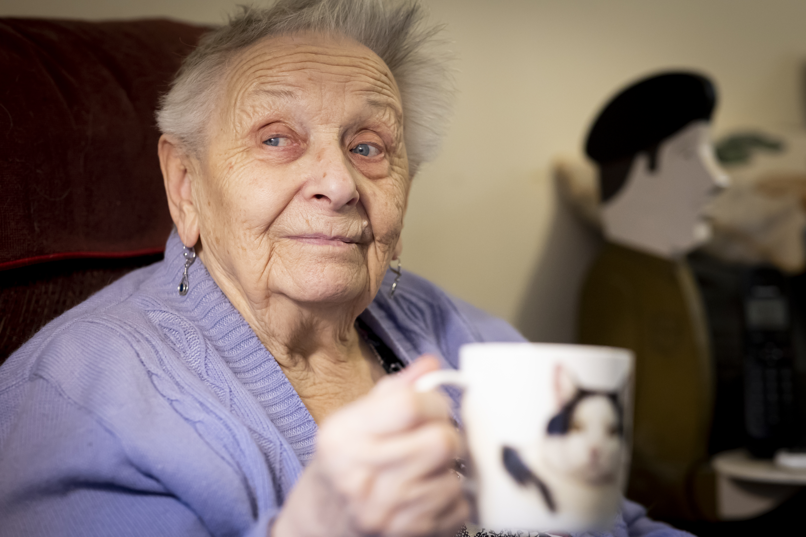
Named Social Worker
A campaign by the Special Interest Group on
Social Work and Ageing

Slide 2

No older person should have to give up their home because of social care needs without having access to the support of an experienced Named Social Worker.
Notes:
The British Association of Social Workers is the professional body for social work in the UK.
We believe that: No older person should have to give up the place they call home because of social care needs without having access to professional advice and support from an experienced Named Social Worker. (BASW 2024)
This presentation sets out the context for this policy, what a social worker offers and the impact they can have, and how older people can have access to social workers when they face the huge life change of a possible move to a care home.

Slide 3
About ageism in social care
The importance of social work in care home admissions
Our aim is to raise awareness, increase understanding and take action against ageism together
What a social worker can do
Our campaign
Get involved
Notes:
This is what the presentation covers and what it aims to do.

Slide 4
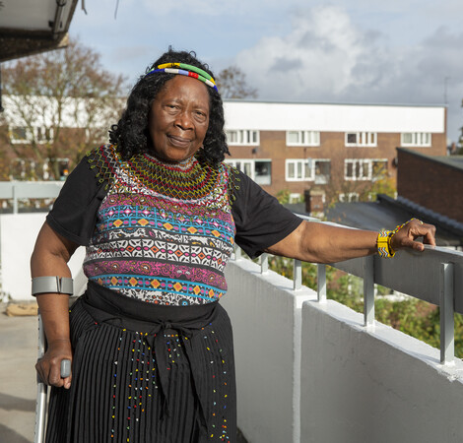
Ageism in social care
Older people are:
Less likely to see a social worker
Receive less funding per head than younger adults
Have fewer creative options than younger adults.
Approximately 1/3 of older people are self-funders.
Notes:
Here is some information about ageism in social care.

Slide 5
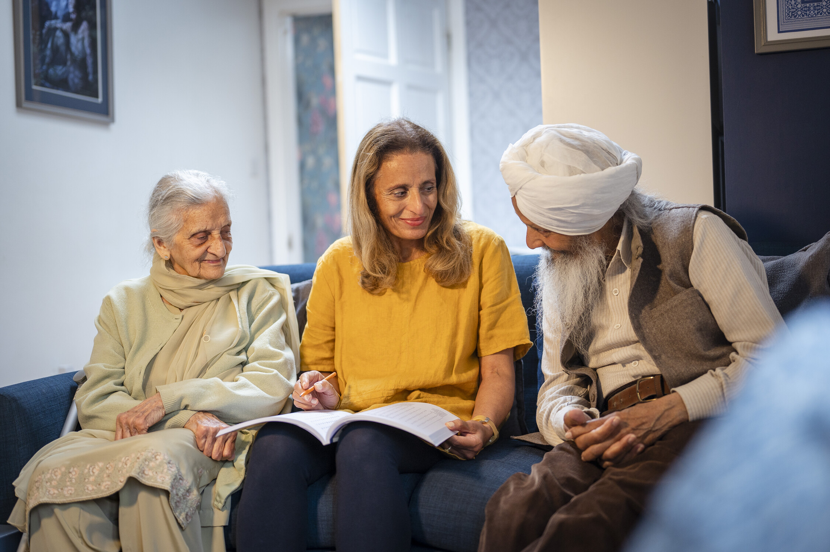
Barriers
Lack of knowledge
Limited networks
Barriers to decision making
Illness
Lack of options
Notes:
These are the barriers that older people face to getting good advice and support about care home admissions.
Many people rely on family or friends to help them, and they may also not have much information or knowledge about how to navigate the system (SWOP 2025).
Most people do not know that social workers provide legal advice to older people and protect their rights (Tanner et al 2023). l Many older people have difficulties with decision making because of illnesses such as dementia.
Some people are discharged from hospital into a temporary care placement that becomes permanent because advice and support is not available to help them get home (SWOP 2025b).
The charity When I Get Old has identified that information about care can be limited to formal options which reduces the scope for people to plan creatively and leads to people thinking that a care home is the only real option (WIGO 2025).

Slide 6
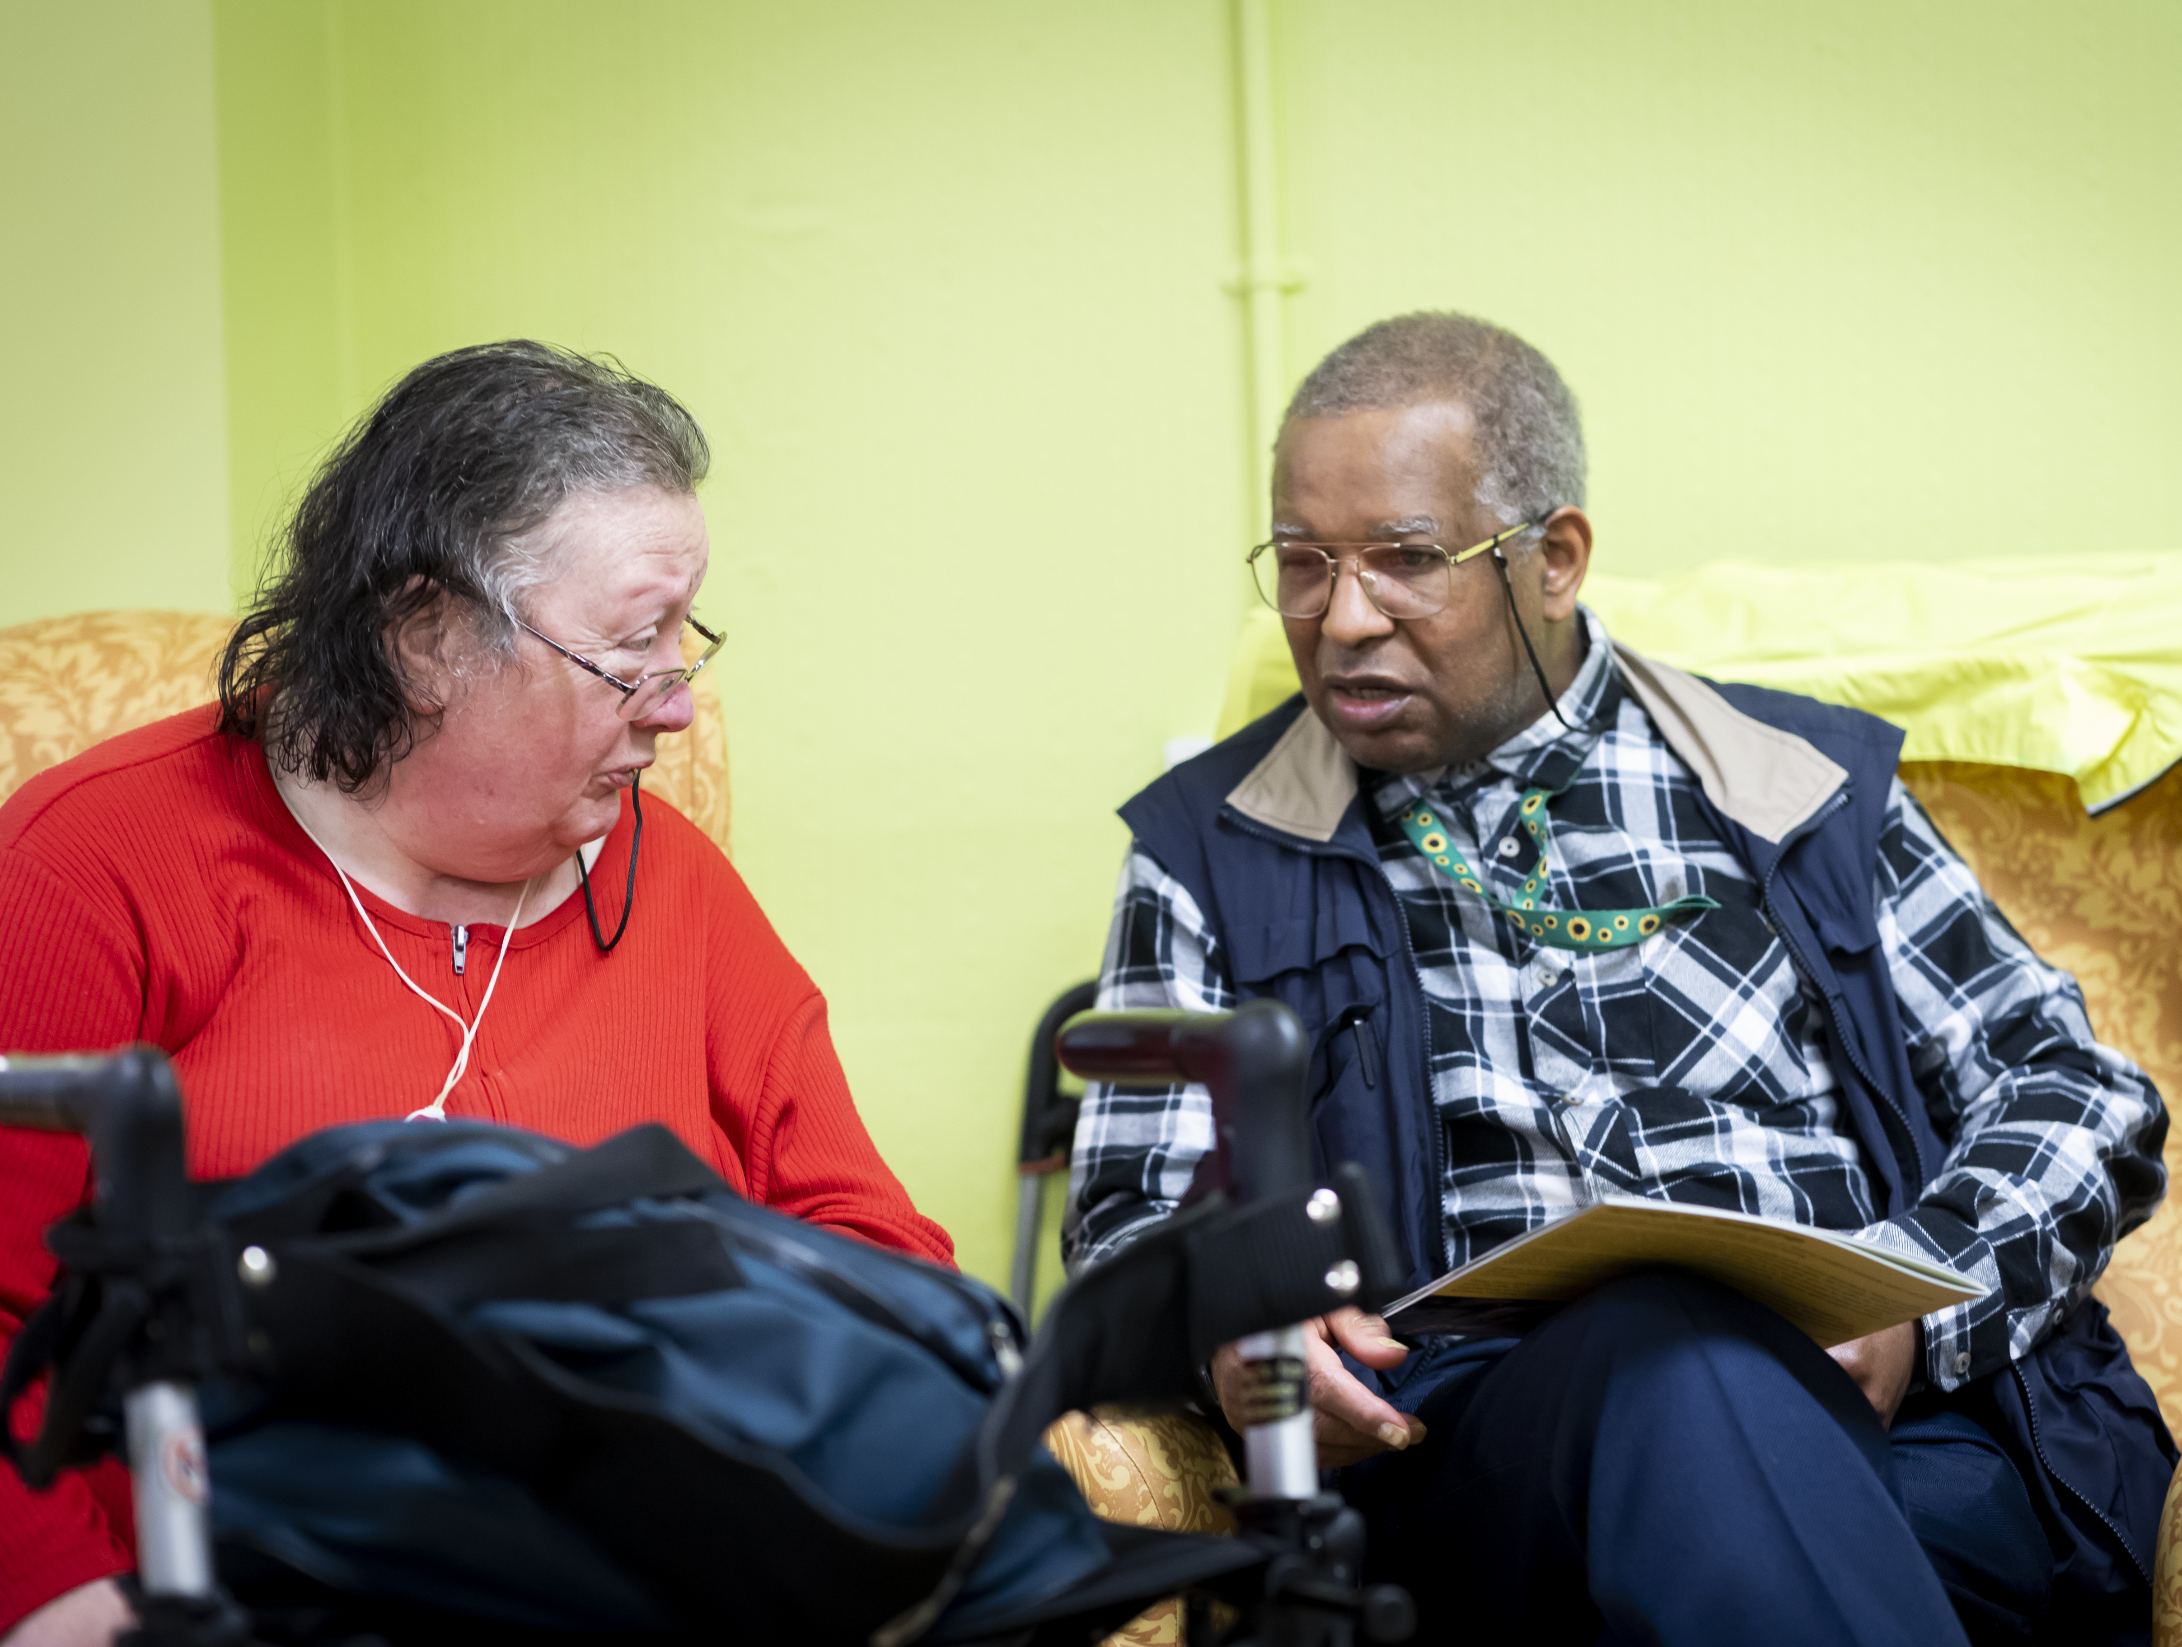
Impact
Unnecessary or inappropriate care and costs
Giving up home when this is not needed
Lack of control over care
Stress and worry.
Notes:
The impact can be significant.
Older people do not understand the funding landscape and social workers would help them to avoid unnecessary or inappropriate costs (Higgs et al 2018).
An older person may give up their home when they do not have sufficient needs to require a move to a care home. Older people may be discharged from hospital into a care home without sufficient follow-up to ensure this is appropriate. It is estimated that 10% of self-funding care home residents would not be eligible for this level of care if they had local authority support (DHSC 2022).
If older people run out of funds then the local authority has to fund their care. This can lead to local authorities picking up an unnecessarily large bill or to the older person having to move from what they expected to be their forever home because a less expensive option would meet their needs. Resolving these situations requires additional time, advice and support from a social worker. There are incidents of poor care in care homes (for example BBC 2024). Access to expert advice and input prior to moving to a care home would help older people and families have more say and control over the care they receive. Input from a social worker could also be supportive to care home staff. Excluding social workers from involvement with care home residents may contribute directly to failures to identify, minimise or respond to abuse (Manthorpe et al 2017).
Older people and their families experience stress and worry when they do not have access to a named person for advice and say that local authority input is less effective when they have to change worker (Tanner et al 2023).

Slide 7
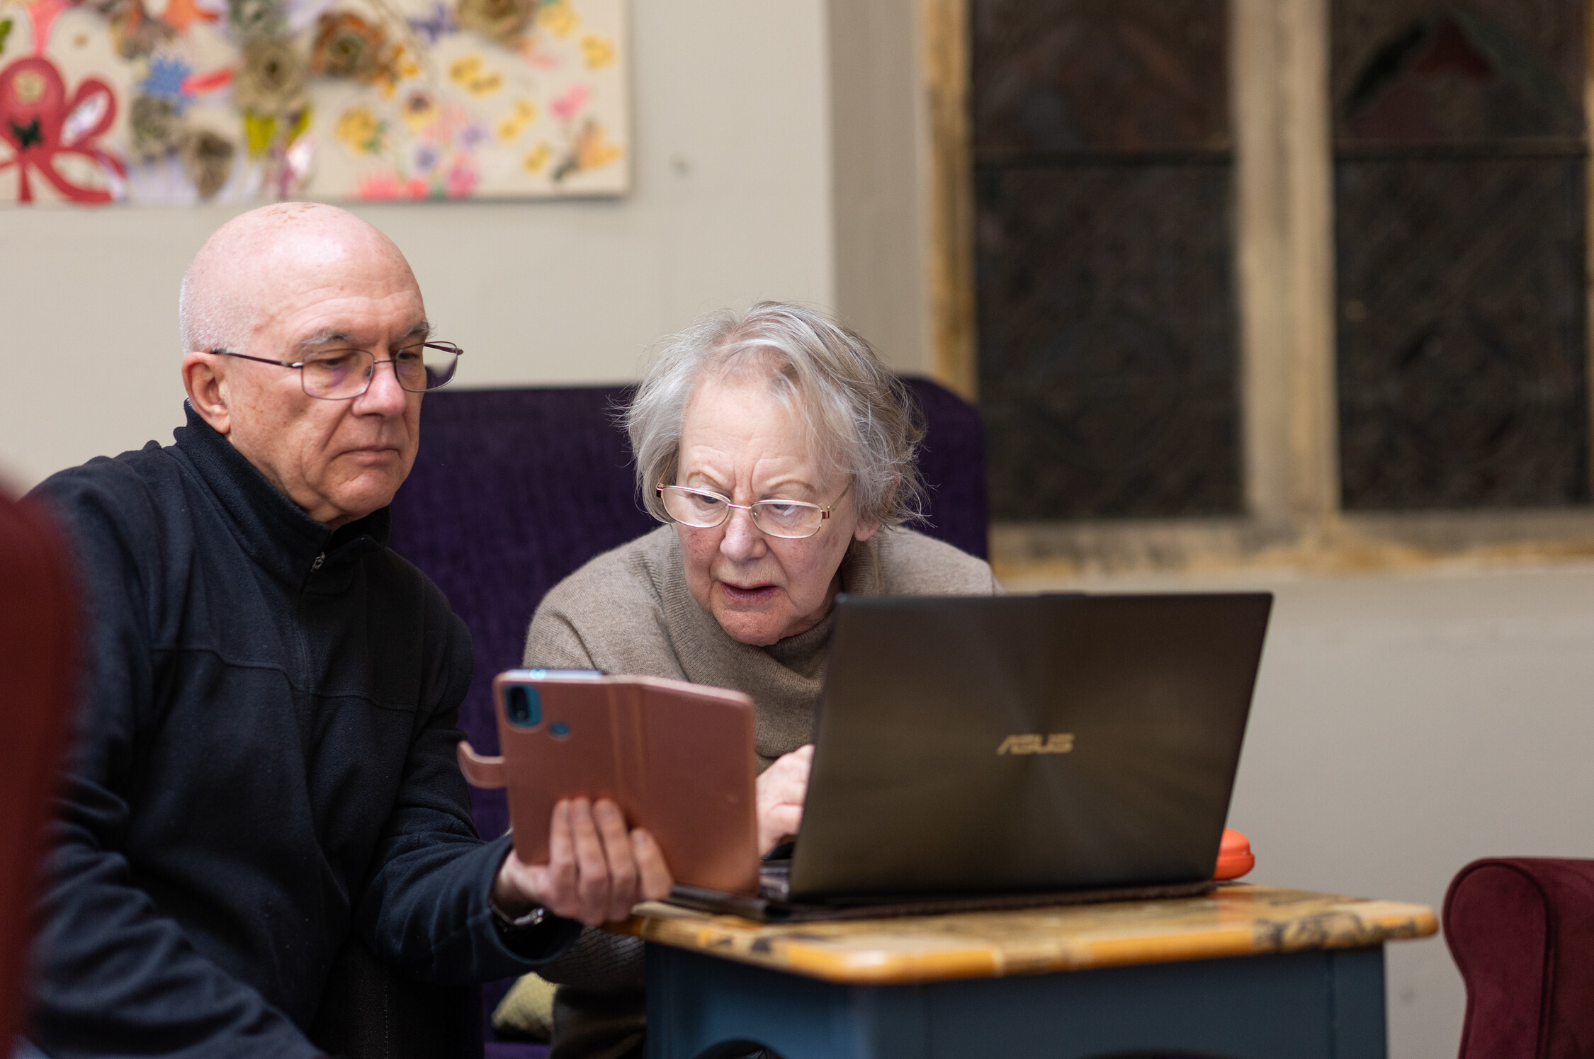
“Older people who pay the full fee for a care home as they have savings above the threshold, or who decide to arrange this privately are a lower priority for advice from their local authority.”
Notes:
This quote is from our resource on The Role of a Social Worker in Care Home Admissions.
You can read the document including references to further information on our Special Interest Group web page Special Interest Group on Social Work & Ageing | BASW
This is one of the big issues – self-funders particularly miss out on essential advice and support.

Slide 8

What a social worker can do
Unique combination of expertise
Support in a major life change
Legal knowledge
Upholding rights
Support to remain at home where possible
Focus on wishes
Help to stay in control.
Notes:
Research (Tanner et al 2023) shows that social workers have a unique combination of expertise that makes a positive difference to the lives of older people and their families. Legal knowledge and practical knowledge of social care systems including funding is a central part of this. This goes hand-in-hand with a commitment to upholding rights and the ability to build therapeutic and reassuring relationships.
Often, older people face decisions about their home at times of crisis and the research shows that social workers’ expertise is particularly valuable when people are struggling to stay in control of what happens, are overwhelmed or are experiencing life changing situations such as a sudden admission to hospital.
Social workers have a professional qualification that includes social care law. They know how to uphold rights, including when people may lack mental capacity to make a decision. They can assess risk and help people remain at home where possible. Above all, they focus on people’s wishes and what matters to them, so they stay in control of what happens.

Slide 9
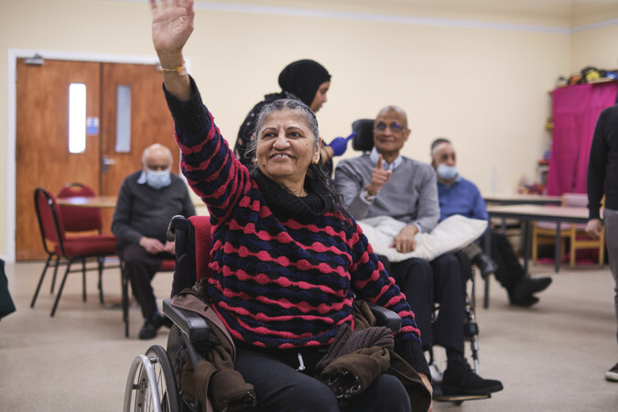
“For starters, what do you know and what’s your name?
A trusted confidant is my need, the same, named social worker fits the bill,”
Notes:
No older person should have to give up the place they call home because of social care needs without having access to professional advice and support from an experienced Named Social Worker.
Access to professional input from a social worker can help people stay at home safely for longer, and ensure that their precious income and savings are used to best effect. This builds on existing best practice and statutory guidance, so is not a major change. However, it gives older people clarity about what they can expect. It creates parity with working-age adults where the importance of a Named Social Worker has already been recognised and found to be effective, for example by the Department of Health and Social Care (King and Romeo 2022).

Slide 10
The change
Local authority assessments
Hospital discharge
Self-funder advice and information and assessment
Prioritising input where the person lacks control.
Notes:
Older people who are eligible for state funding to move into alternative accommodation such as a care home will already have a local authority assessment and advice in order to access the funding. There should be social work input.
If the person is being assessed for discharge from hospital and a care home is being recommended, a social worker should take a lead or provide support to the worker who is planning the discharge.
Additional work is needed by local authorities to ensure that self-funders are aware they are entitled to advice and assessment, and for social workers to be available to provide this.
Older people, who meet national criteria to pay for their own care, are entitled to an assessment and advice from the local authority but may not receive this (NIHR 2021). Statutory Guidance on social care law (DHSC 2025) highlights the importance of social work advice in complex situations (3.34), complex assessments (6.7) and person centred planning (10.35).
Having a Named Social Worker for advice does not necessarily mean that the social worker provides all of the input to that person. The social worker could act as a named mentor to another member of staff and provide proportionate input.
Where there is conflict or the person is at risk of not being in control of what happens, the input of a social worker should be prioritised.

Slide 11
Advocacy
Policy and practice
Education and evidence
Special Interest Group
Challenge ageism.
Advocate for more effective social work practice in later life.
Notes:
Here is some information about the Special Interest Group.
Set up in 2024
UK wide Special Interest Group
Decided on the name Social Work and Ageing – ageing is different for different people
The purpose is to challenge ageism and advocate for more effective social work practice in later life
We work in allyship – social workers, older people, carers, often overlapping roles
Areas of work are advocacy; improving policy and practice; strengthening education and evidence.
The named worker policy is a central part of our work.

Slide 12
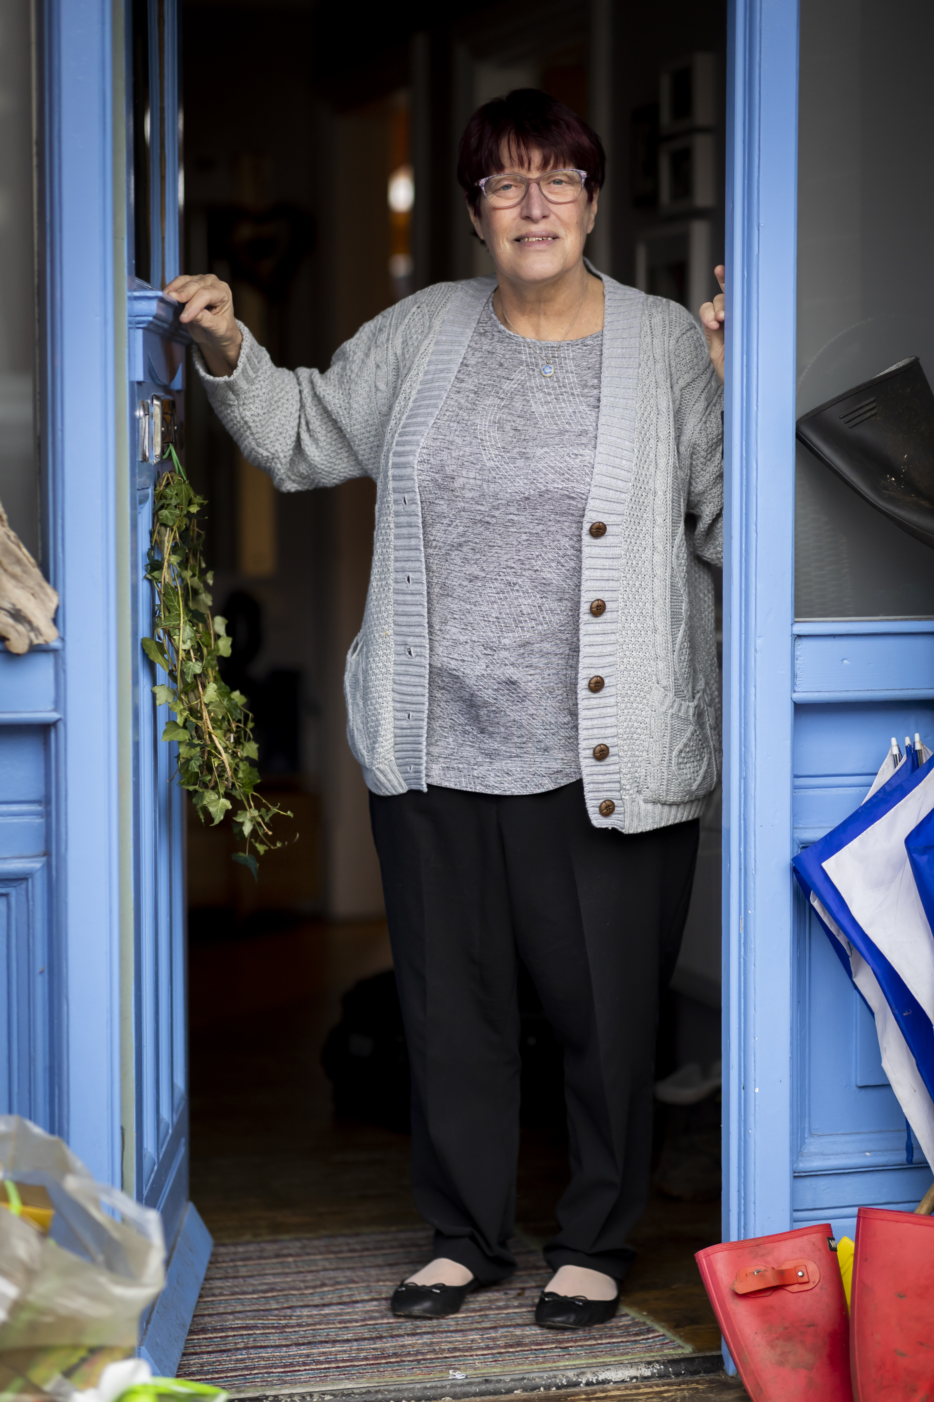
Campaign actions
Articles and events
Share good practice
Contribute to policy
Guidance on role of social worker in care home admissions.
Notes:
What we have done so far:
Articles in social work magazines and BASW website
Events including BASW conference, Age without Limits day, British Society of Gerontology conference
Sharing good practice e.g. named worker project in Walsall
Information for students about the importance of the role
Submission to Casey review of Adult social Care
Guidance for social workers on the role of social worker in care home admissions

Slide 13
Action
Get involved
Review
Awareness
Social Work input to be prioritised
Sufficient social workers.
Reaffirm
Recognise
Recommend
Request
Notes:
We are asking for:
Awareness of the importance of social work for older people facing this life-change.
In the short term, for social work input to people in this situation to be prioritised.
In the longer term, for sufficient social workers to be able to support people in later life.
Take action:
Leaders – Review the advice and support you give to people at risk of losing the place they call home, and prioritise social work input for those who need it most.
Policy makers – Recognise the importance of Named Social Work input for people most at risk of giving up the place they call home without good advice and support.
Older people, carers and families - Ask to speak to a social worker when you are concerned that someone might lose the place they call home without good advice and support.
Advocacy and advice organisations – Work with our campaign to ensure that older people, carers and families get good advice and support from a suitably qualified person.
Social workers – Support our campaign by sharing your experience of good practice.
Social work educators – Encourage social work students to work with older people.
Care homes – Be aware that older people, carers and families benefit from social work advice and support when they are considering a move from their home.

Slide 14

Thank you
Special Interest Groups | BASW
Notes:
Thank you

